Slide 1
ANZ Management – Virtual INTERNSHIP

Slide 2
Task 1:
This task is based on a synthesized transaction dataset containing 3 months’ worth of transactions for 100 hypothetical customers. It contains purchases, recurring transactions, and salary transactions.
The dataset is designed to simulate realistic transaction behaviors that are observed in ANZ’s real transaction data, so many of the insights you can gather from the tasks below will be genuine.
Problem Statement: Start by doing some basic checks – are there any data issues? Does the data need to be cleaned? Gather some interesting overall insights about the data. For example -- what is the average transaction amount? How many transactions do customers make each month, on average?

Slide 3
Exploratory Data Analysis
Segment the dataset and draw unique insights, including visualization of the transaction volume and assessing the effect of any outliers.

Slide 4
Data Preprocessing
Duplicates - No duplicates
Missing Values - There are 4326 records missing values in columns such as merchant_state, merchant_long_lat, merchnat_suburb, merchant_id, card_present_flag
Outliers – There are several outliers for 'balance' and 'amount' feature and hence they are 'right skewed'

Slide 5
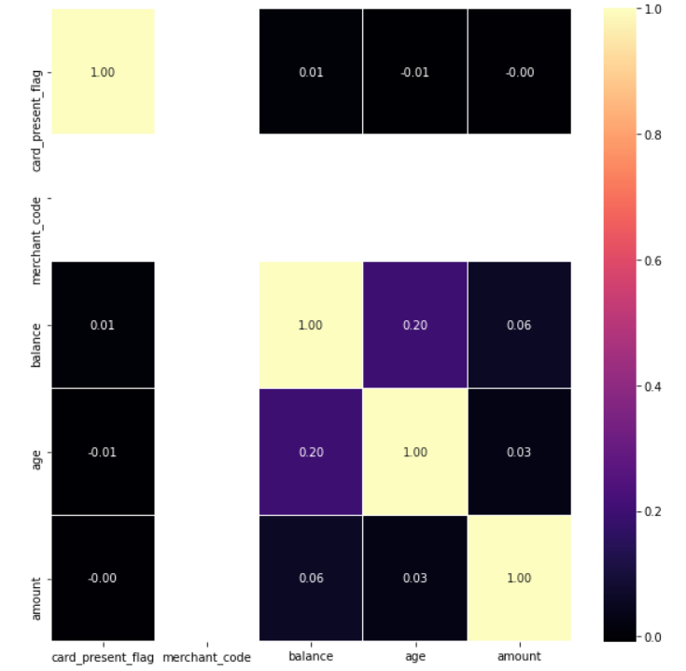
EDA Visualization

Slide 6
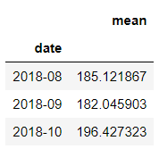
Insights
Average Transaction amount is AUD 187.93
Balance is positively correlated with age
Monthly transactions are high in month of October
Avg Transaction volume by month
There is huge transaction volume from 'NSW'

Slide 7
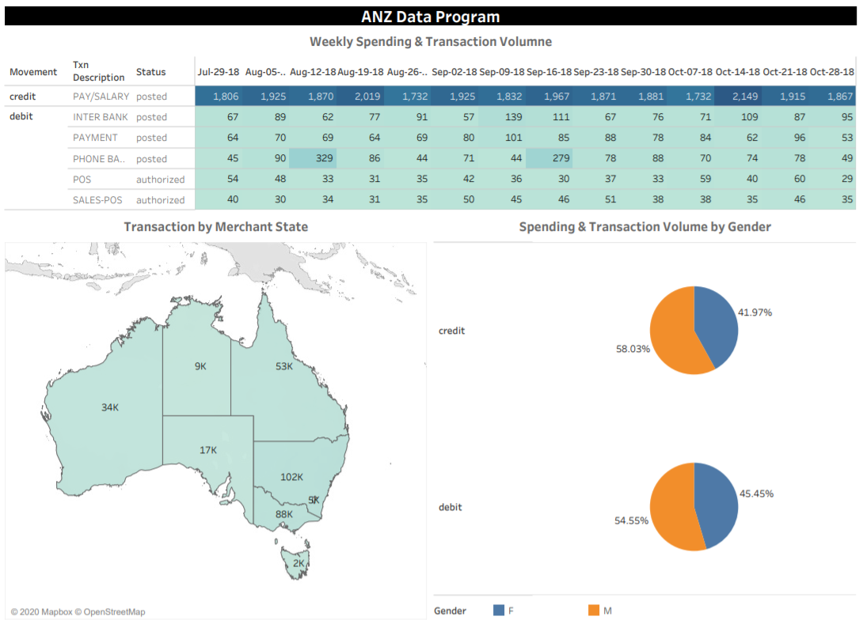
Tableau Visualization of ANZ Transaction Data Set

